Slide 2
Announcements: Wrapping up the quarter
Project
Proposal grades on Sakai
Please read your feedback: you are responsible for making changes if needed
Emailed the SWAN dataset manager– no answer on why Hispanic/Latinx individuals are not measured in Visit 10
When I get an answer, I’ll let you all know through Slack (likely in Summer)
Homework
Homework 4: turned in redo, grading redo’s
Homework 5: all grades released, redo due 6/9
Homework 6: grading, redo due 6/14
Midterm (quarter) feedback: posted in Sakai announcements
Due 6/9 by midnight!
“On call” for project: Thursday or Friday
Hop on a Webex meeting and answering emails/Slacks

Slide 3
Class 16 Learning Objectives
Revisit the logistic regression diagnostic plots
Identify and resolve poorly fit or influential points
Present and interpret odds ratios in the context of our final model
Identify outcomes that can be modelled by Poisson regression

Slide 4
Class 16 Learning Objectives
Revisit the logistic regression diagnostic plots
Identify and resolve poorly fit or influential points
Present and interpret odds ratios in the context of our final model
Identify outcomes that can be modelled by Poisson regression

Slide 5
Review of Overall Measure of Fit: GLOW Study
Preliminary final model: $logit\left(π\left(x\right)\right)=β_{0}+β_{1}Age_{i}+β_{2}Height_{i}+β_{3}I\left(PF_{i}=“Yes”\right)+β_{4}I\left(MF_{i}=“Yes”\right)+β_{5}I\left(AA_{i}=“Yes”\right)+β_{6}I\left(RR=“Greater”\right)+β_{7}Age_{i}×I\left(PF_{i}=“Yes”\right)+β_{8}I\left(MF_{i}=“Yes”\right)×I\left(AA_{i}=“Yes”\right)$
We can examine the overall model fit using:
Not comparing to any other models:
Pearson residuals: Not appropriate for this model
Hosmer-Lemeshow: $\hat{C}=\text{6.39}$, p-value = 0.60
AUC-ROC: 0.7286
Can be used to compare to other models:
AUC-ROC: 0.7286
AIC/BIC: 518.50 / 556.43
Hosmer-Lemeshow test and AUC-ROC both indicating that the model fits the data well (acceptable under AUC suggestions)

Slide 6
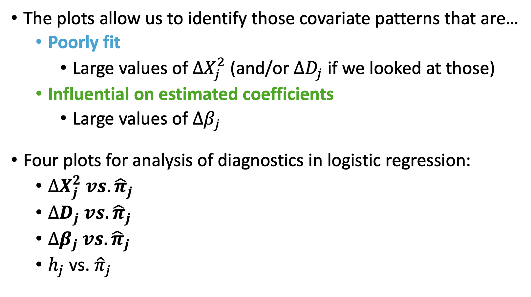
Visual Diagnostics of Logistic Regression
The plots allow us to identify those covariate patterns that are…
Poorly fit
Large values of $∆X_{j}^{2}$ (and/or $∆D_{j}$ if we looked at those)
Influential on estimated coefficients
Large values of $∆β_{j}$
Four plots for analysis of diagnostics in logistic regression:
$∆X_{j}^{2} vs. {\hat{π}}_{j}$
$∆D_{j} vs. {\hat{π}}_{j}$
$∆β_{j} vs. {\hat{π}}_{j}$
$h_{j}$ vs. ${\hat{π}}_{j}$

Slide 7
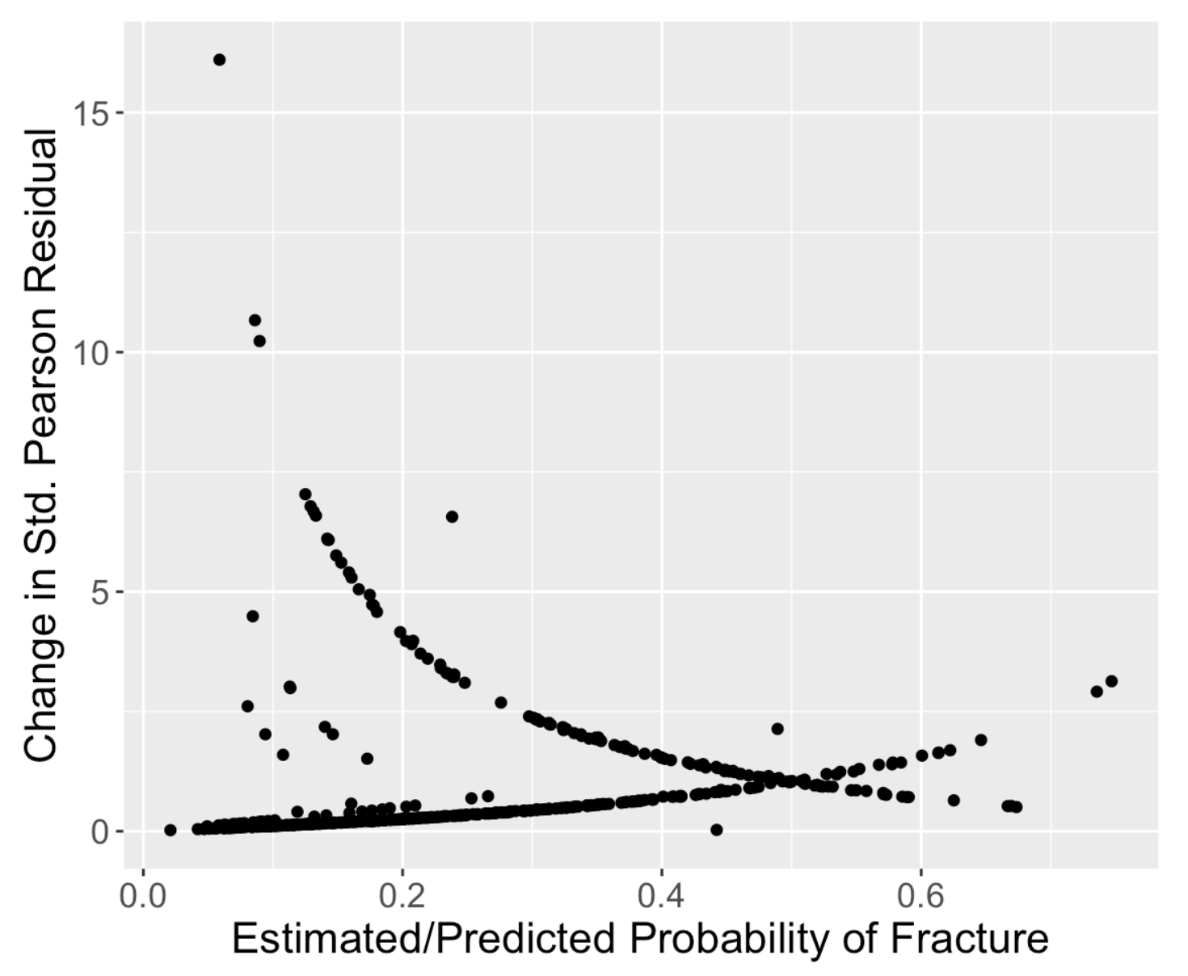
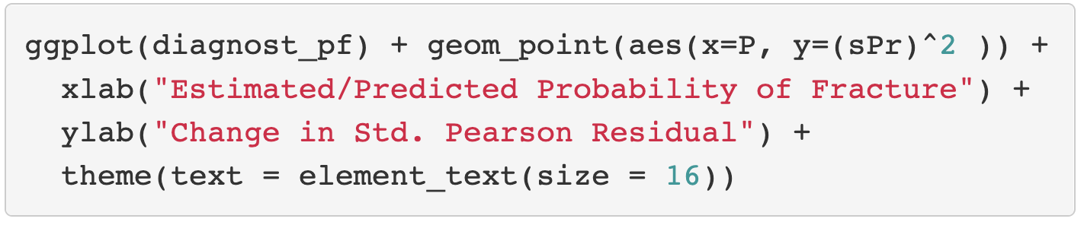
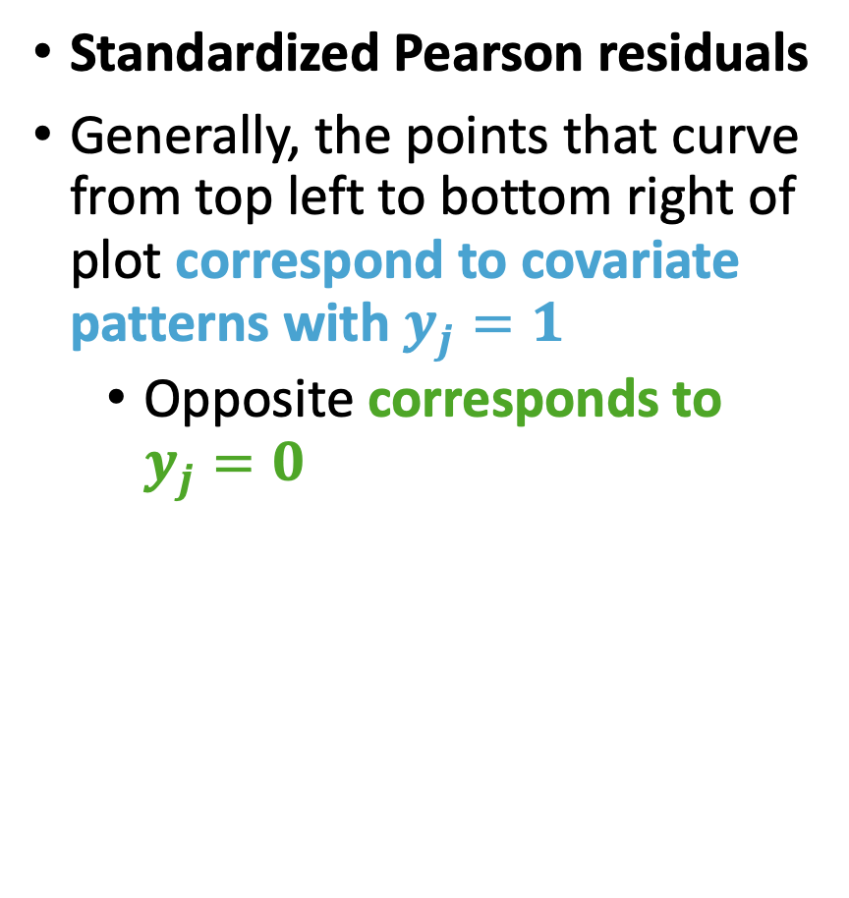
GLOW Study: Plot of $∆X_{j}^{2} vs. {\hat{π}}_{j}$ (I)
Standardized Pearson residuals
Generally, the points that curve from top left to bottom right of plot correspond to covariate patterns with $y_{j}=1$
Opposite corresponds to $y_{j}=0$

Slide 8
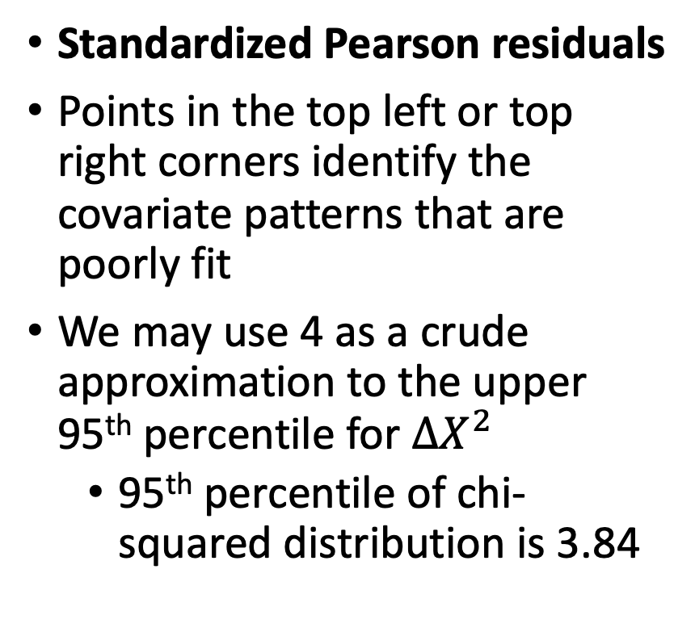
GLOW Study: Plot of $∆X_{j}^{2} vs. {\hat{π}}_{j}$ (II)
Standardized Pearson residuals
Points in the top left or top right corners identify the covariate patterns that are poorly fit
We may use 4 as a crude approximation to the upper 95th percentile for $∆X^{2}$
95th percentile of chi-squared distribution is 3.84

Slide 9
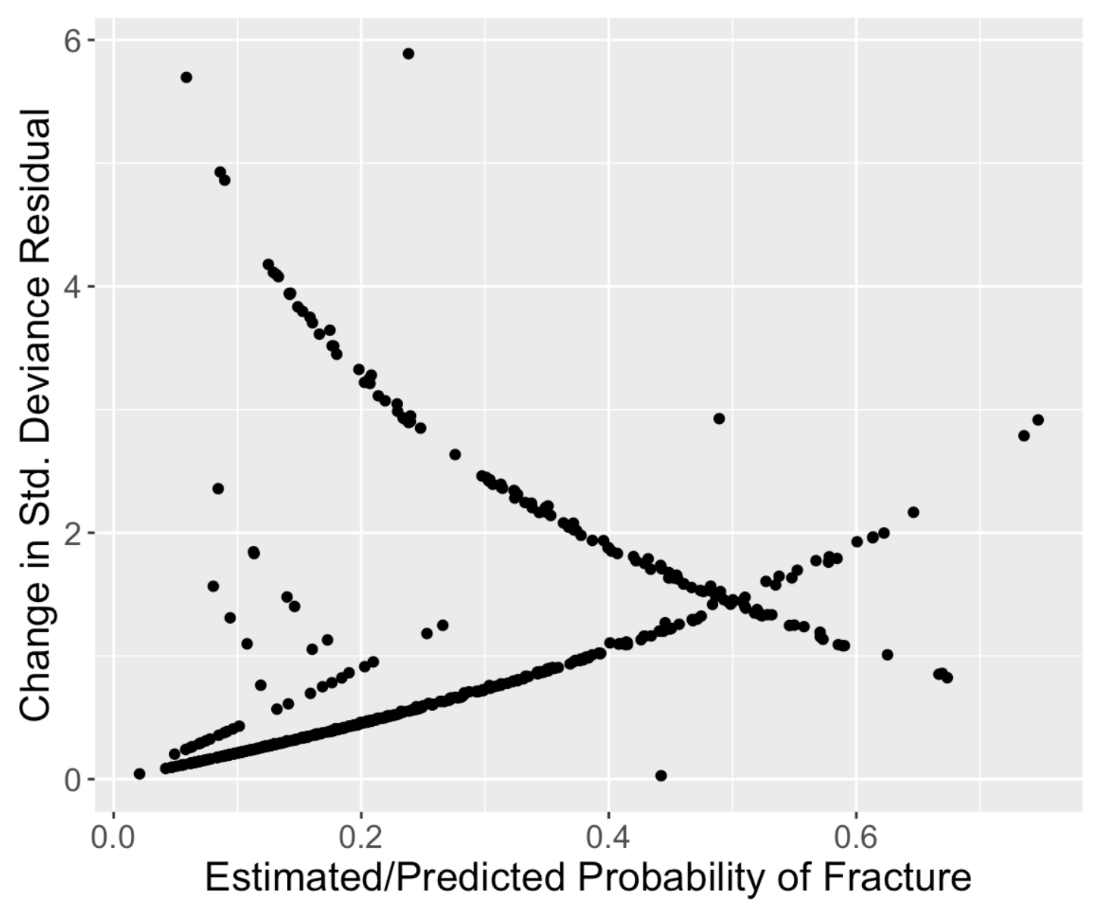
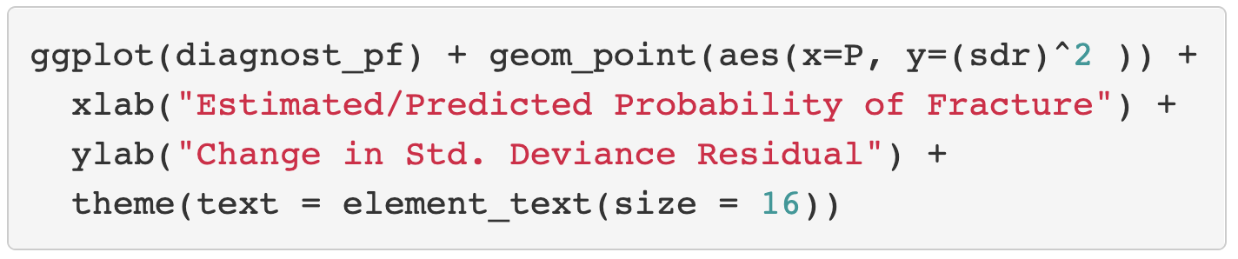
GLOW Study: Plot of $∆D_{j} vs. {\hat{π}}_{j}$
Standardized Deviance residuals
Same investigation as Pearson residuals
Points in the top left or top right corners identify the covariate patterns that are poorly fit
Use 4 as a crude approximation to the upper 95th percentile and 4.5 as a cut off

Slide 10
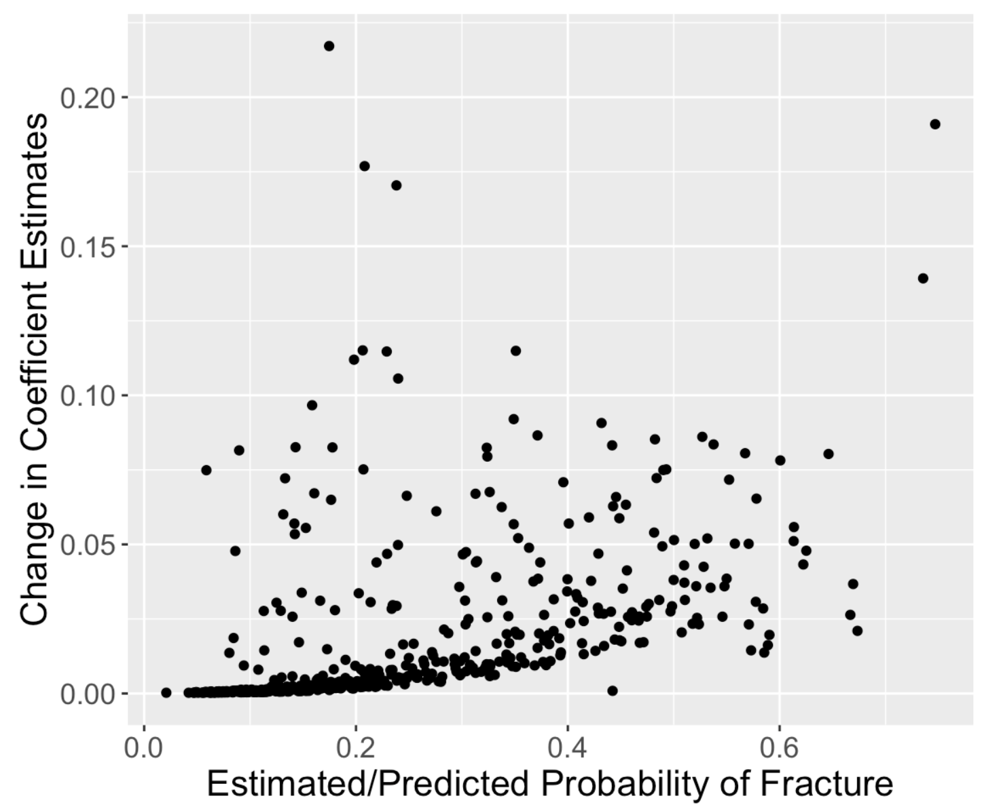
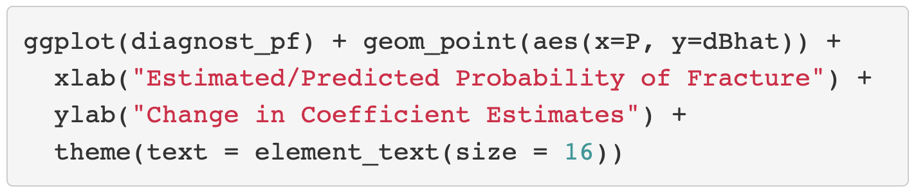
GLOW Study: Plot of $∆β_{j} vs. {\hat{π}}_{j}$
Change in coefficient estimates
About 5 points that are above 0.125 change in coefficients
Book recommends flagging certain covariate patterns if change in coefficient estimates are greater than 1

Slide 11
Class 16 Learning Objectives
Revisit the logistic regression diagnostic plots
Identify and resolve poorly fit or influential points
Present and interpret odds ratios in the context of our final model
Identify outcomes that can be modelled by Poisson regression

Slide 12
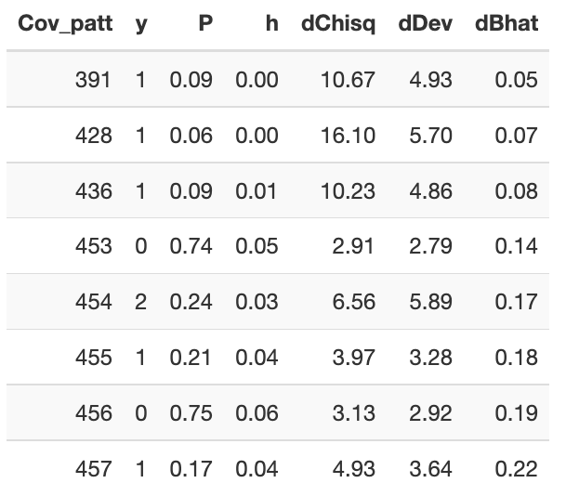
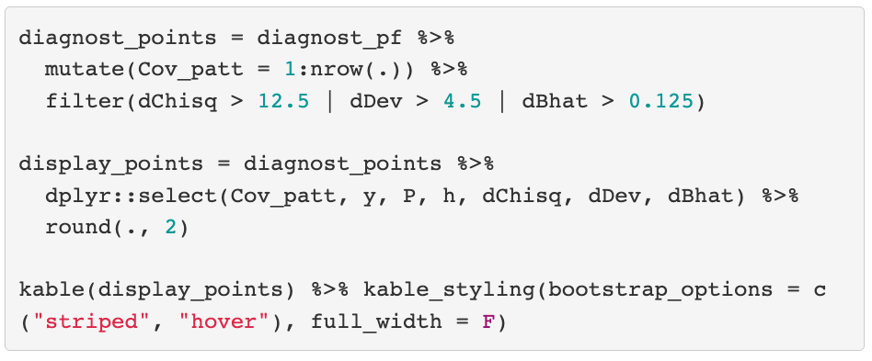
Find the poorly fit/influential observations (I)
We visually identified covariate patterns that may be poorly fit or influential
How do we know which covariate patterns were the ones in the plot?

Slide 13
Find the poorly fit/influential observations (II)
For each covariate pattern that is poorly fit/influential based on the visual plots
Take the observations out of the dataset
Run the preliminary final model using the filtered dataset
Look at the coefficients: did they change a lot?
Rule of thumb: >20% change
Even if there is a large change
Think about the observation
Are the values within reason? If yes-ish, then keep it
Short version (as you accumulate lots of experience): For the covariate pattern, is each covariate observation within reason?
Then keep the observation!
This might just be a unique observation!

Slide 14
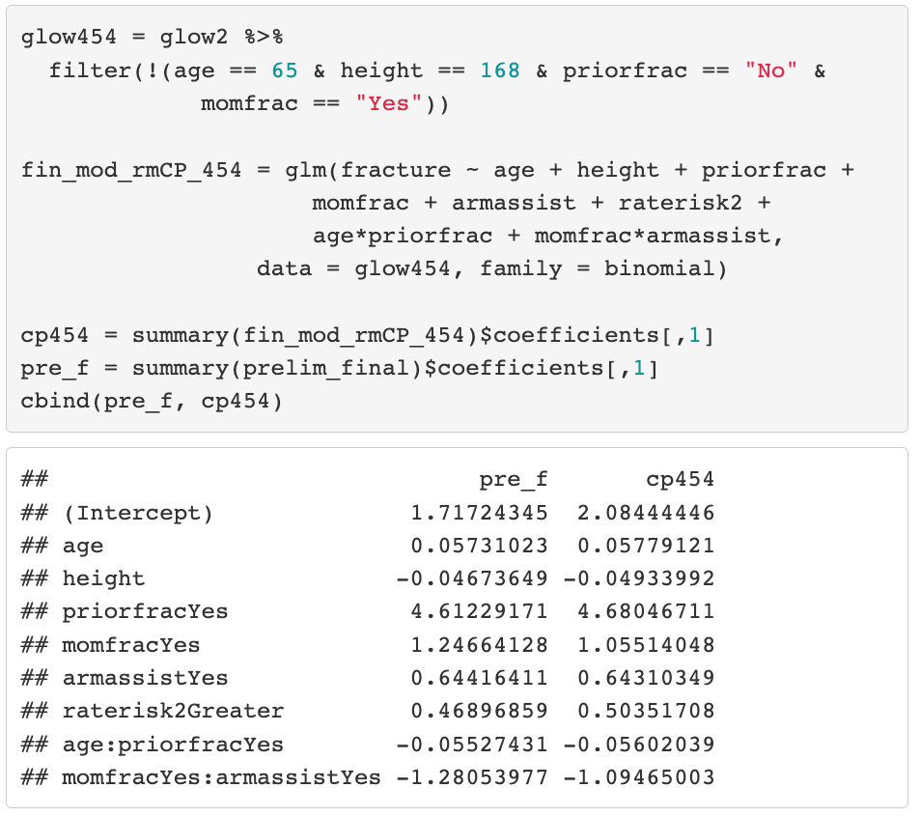
Find the poorly fit/influential observations (III)
Example of one covariate pattern (#454 in previous slide)
Take the observations out of the dataset
Run the preliminary final model using the filtered dataset
Look at the coefficients: did they change a lot?
Rule of thumb: >20% change
Even if there is a large change
Think about the observation
Are the values within reason? If yes-ish, then keep it

Slide 15
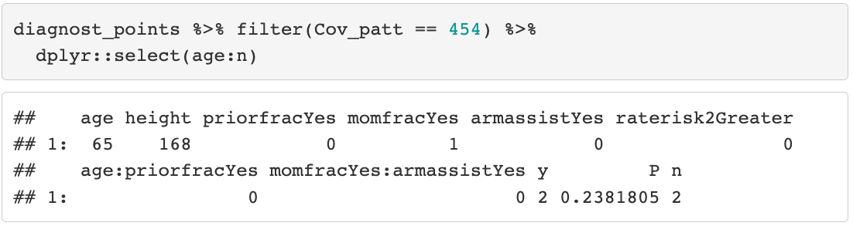
Find the poorly fit/influential observations (III)
Example of one covariate pattern (#454 in previous slide)
Take the observations out of the dataset
Run the preliminary final model using the filtered dataset
Look at the coefficients: did they change a lot?
Rule of thumb: >20% change
Even if there is a large change
Think about the observation
Are the values within reason? If yes-ish, then keep it

Slide 16
Refit the model / omit observations?
We decide not to take any values out
For the most part, these diagnostics encourage you to think about the data instead of running a model fit blindly
I rarely take values out of my model
Diagnostic process mostly helps me identify observations that may have incorrectly reported measurements
If you do take values out, then refit the model with the new dataset
You may think about reporting both results to the reader: see this Stack Exchange answer

Slide 17
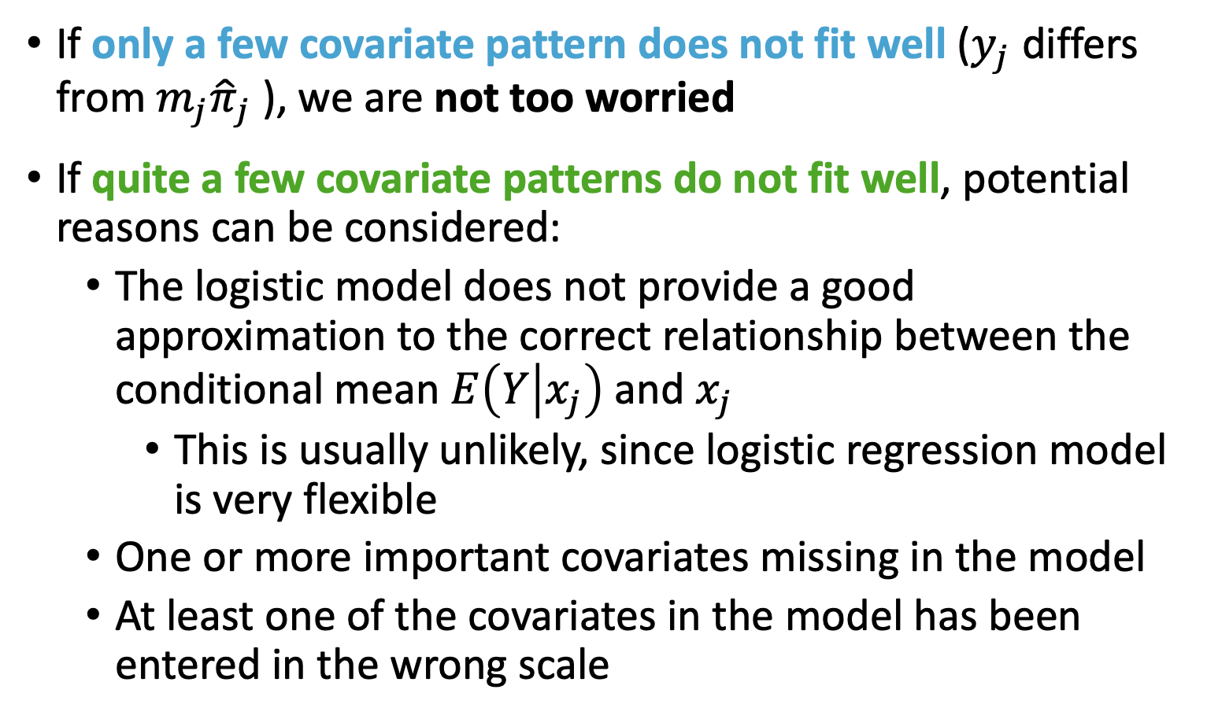
Three potential reasons why model fits poorly
If only a few covariate pattern does not fit well ($y_{j}$ differs from $m_{j}{\hat{π}}_{j}$ ), we are not too worried
If quite a few covariate patterns do not fit well, potential reasons can be considered:
The logistic model does not provide a good approximation to the correct relationship between the conditional mean $E\left(Y | x_{j}\right)$ and $x_{j}$
This is usually unlikely, since logistic regression model is very flexible
One or more important covariates missing in the model
At least one of the covariates in the model has been entered in the wrong scale

Slide 18
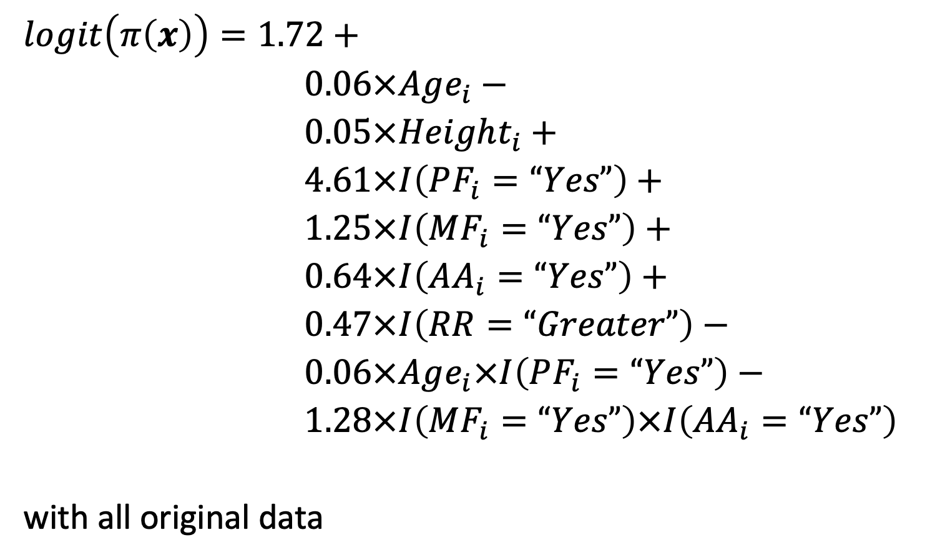
Finally, our final model <3
$$logit\left(π\left(x\right)\right)=\text{1.72}+$$ $0.06×Age_{i}−$ $0.05×Height_{i}+$
$\text{4.61}×I\left(PF_{i}=“Yes”\right)+$
$\text{1.25}×I\left(MF_{i}=“Yes”\right)+$
$\text{0.64}×I\left(AA_{i}=“Yes”\right)+$
0.47$×I\left(RR=“Greater”\right)−$
$\text{0.06}×Age_{i}×I\left(PF_{i}=“Yes”\right)−$
$\text{1.28}×I\left(MF_{i}=“Yes”\right)×I\left(AA_{i}=“Yes”\right)$
with all original data
Note: A colleague might care about seeing this, but most of the time your audience does not

Slide 19
10 minute break?

Slide 20
Class 16 Learning Objectives
Revisit the logistic regression diagnostic plots
Identify and resolve poorly fit or influential points
Present and interpret odds ratios in the context of our final model
Identify outcomes that can be modelled by Poisson regression

Slide 21
We have our final model: Now what?
Now it’s time to address inferential goals of our study!
What was the goal of the GLOW study?
What variables are associated with fracture during a year of follow-up?
How associated are they? (measure with ORs)
In a final report: use estimates of the coefficients to produce estimates of the odds ratios
Do not report the coefficients in your results
Do not write any interpretation results using the coefficients
Do report the odds ratios and their interpretations

Slide 22
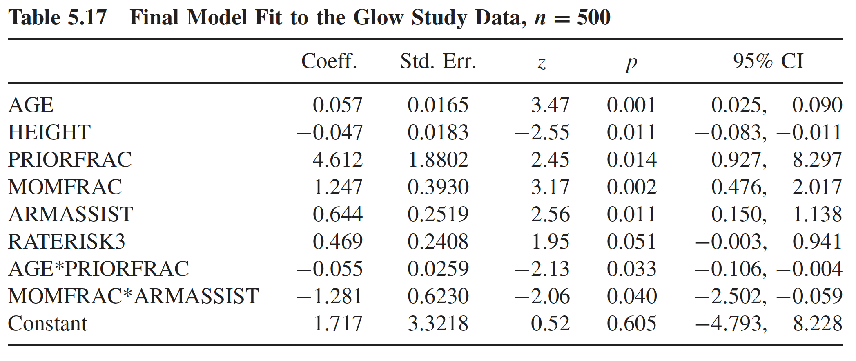
GLOW Study Final Model Table
For logistic regression, we do not present the coefficients as is
These were our coefficient estimates:
We want to present the odds ratios for all of these

Slide 23
ORs: Things to consider / Questions to ask yourself
What type of variable is it?
Binary: take note of reference
Continuous: pick a unit increase
Multi-level categorical: take note of reference group
Is the variable involved in an interaction?
Only in main effects: can interpret OR of main effect alone
Main effect and interaction: need to calculate OR using main effect and interaction

Slide 24
OR for covariates with main effect only
We learned in Class 7/8 that we can compute odds ratios (and 95% CI) by taking the exponent of the coefficient
In a model containing interactions, we can do this only for the variables that are not involved in an interaction

Slide 25
Poll Everywhere Question 1

Slide 26
OR for covariates with main effect only
Table below shows the estimated OR and 95% for two covariates: self-reported risk of fraction and height
Only covariates that are not involved with interaction in this model
Variable | Odds Ratio | 95% CI
Self-reported risk of fracture compared to others
Less or Same | 1.00
Greater | 1.60 | 1.00, 2.56
Height (by 5 cm) | 0.79 | 0.66, 0.95

Slide 27
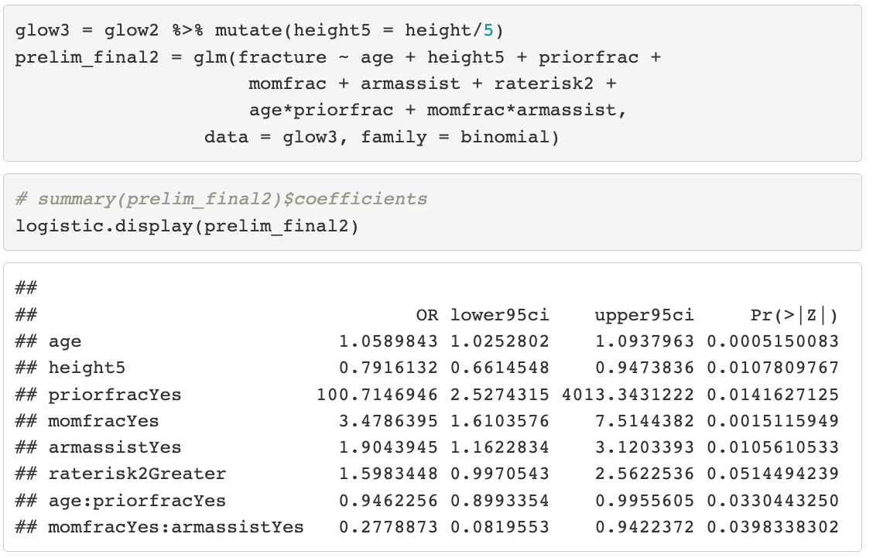
OR for covariates with main effect only (code)
Variable | Odds Ratio | 95% CI
Self-reported risk of fracture compared to others
Less or Same | 1.00
Greater | 1.60 | 1.00, 2.56
Height (by 5 cm) | 0.79 | 0.66, 0.95

Slide 28
Interpreting OR for Self-reported Rated Risk (I)
For raterrisk2 (self-reported risk, categorized as either greater than others vs. Less than or same to others), the estimated odds ratio is 1.6.
Interpretation: The odds of fracture among women self-reported their risk of fracture as greater than others is 1.6 times (95% CI: 1.00, 2.56) the odds of fracture for a woman who rated their risk as the same or less than others, adjusting for age, height, mom’s fracture, prior fracture, and arm assistance

Slide 29
Interpreting OR for Self-reported Rated Risk (II)
Incorrect (but widely seen) interpretation:
The risk of fracture among women whose self-reported risk is greater than others is 1.6 times larger than the risk of fracture of a similar women (with respect to the other covariates in the model) who rate their risk as the same or less than others.
This is to interpret odds ratio as if it is relative risk
Which is only OK when the outcome is a “rare” event
Rule of thumb: When outcome occurs less than 10% of time, OR approximate to RR.
Therefore this argument is incorrect since in the GLOW data, 25% of the individuals had a fracture
When the event is not rare, the OR overestimates the RR

Slide 30
Interpreting OR for height
We prefer to compute OR for height in unit of 5 (5 centimeters)
OR = 0.79 (95% CI: 0.66-0.95)
Interpretation: For every 5 cm increase in height there is a 0.79-fold decrease in the odds of fracture and the decrease could be as much as a 0.66-fold or as little as a 0.95-fold decrease with 95% confidence after controlling for other covariates in the model.
Alternative interpretation (using % change): for every increase of 5 cm in height there is a 21% decrease in the odds of fracture and this decrease could be as much as 34% or as little as 5% with 95% confidence after controlling for other covariates in the model.

Slide 31
OR for covariates with interaction (I)
Follow slightly different procedures depending on the type of variables in the interaction
Categorical x categorical
Categorical x continuous
Continuous x continuous

Slide 32
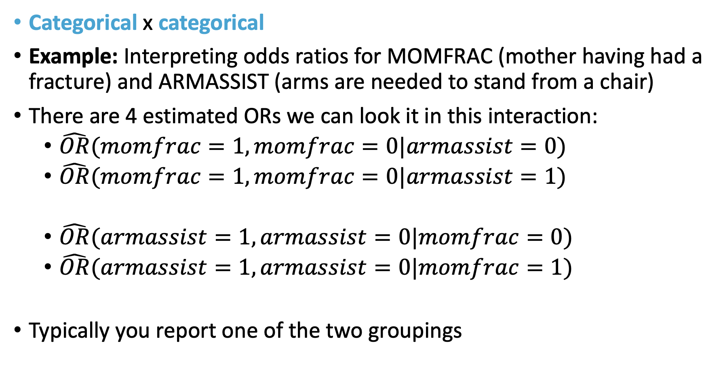
OR for covariates with interaction (II)
Categorical x categorical
Example: Interpreting odds ratios for MOMFRAC (mother having had a fracture) and ARMASSIST (arms are needed to stand from a chair)
There are 4 estimated ORs we can look it in this interaction:
$\hat{OR}(momfrac=1, momfrac=0|armassist=0)$
$\hat{OR}(momfrac=1, momfrac=0|armassist=1)$
$\hat{OR}(armassist=1,armassist=0|momfrac=0)$
$\hat{OR}(armassist=1,armassist=0|momfrac=1)$
Typically you report one of the two groupings

Slide 33
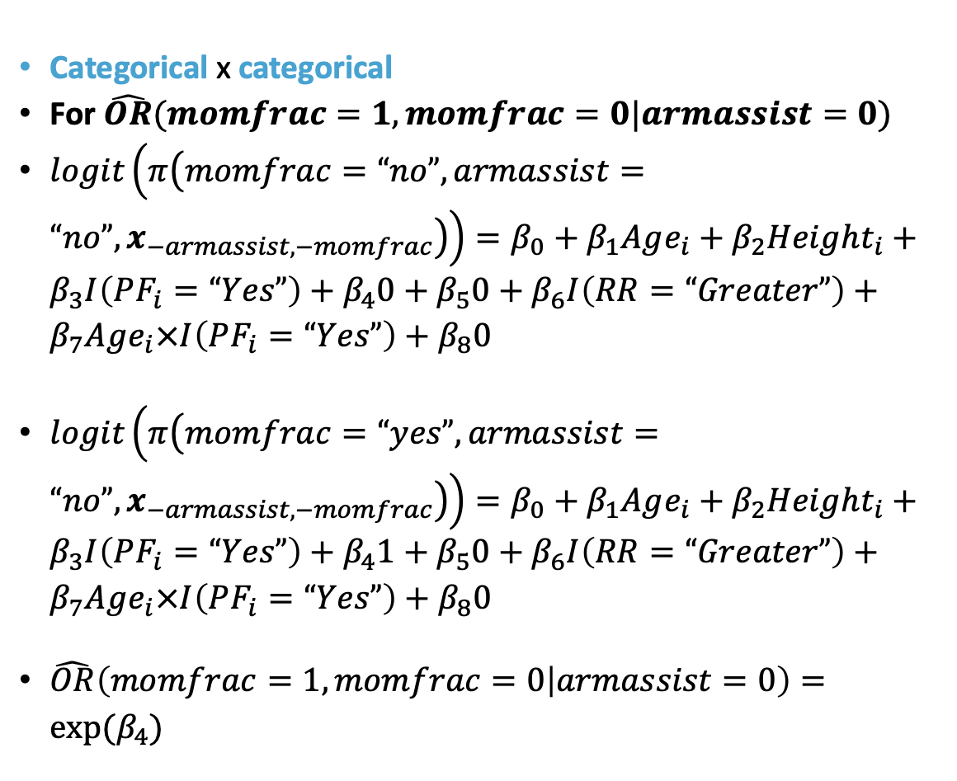
OR for covariates with interaction (III)
Categorical x categorical
For $\hat{OR}(momfrac=1, momfrac=0|armassist=0)$
$logit\left(π\left(momfrac=“no”,armassist=“no”,x_{−armassist, −momfrac}\right)\right)=β_{0}+β_{1}Age_{i}+β_{2}Height_{i}+β_{3}I\left(PF_{i}=“Yes”\right)+β_{4}0+β_{5}0+β_{6}I\left(RR=“Greater”\right)+β_{7}Age_{i}×I\left(PF_{i}=“Yes”\right)+β_{8}0$
$logit\left(π\left(momfrac=“yes”,armassist=“no”,x_{−armassist, −momfrac}\right)\right)=β_{0}+β_{1}Age_{i}+β_{2}Height_{i}+β_{3}I\left(PF_{i}=“Yes”\right)+β_{4}1+β_{5}0+β_{6}I\left(RR=“Greater”\right)+β_{7}Age_{i}×I\left(PF_{i}=“Yes”\right)+β_{8}0$
$\hat{OR}\left(momfrac=1, momfrac=0 | armassist=0\right)=exp⁡(β_{4})$

Slide 34
OR for covariates with interaction (IV)
Categorical x categorical
Example: Interpreting odds ratios for MOMFRAC (mother having had a fracture) and ARMASSIST (arms are needed to stand from a chair)
Variable 1 | Variable 2 | Odds Ratio | 95% CI
Arm assistance needed to rise | History of mother having had a fracture
 | No | 1.00
 | Yes | 0.97 | 0.38, 2.49
Arm assistance not needed to rise | History of mother having had a fracture
 | No | 1.00
 | Yes | 3.50 | 1.61, 7.51

Slide 35
OR for covariates with interaction (V)
Interpretations:
For individuals who need arm assistance to rise, the odds of fracture for individuals with a history of mother with a fracture is 0.97 times (95% CI: 0.38, 2.49) the odds of fracture for individuals with no history of mother with a fracture.
For individuals who do not need arm assistance to rise, the odds of fracture for individuals with a history of mother with a fracture is 3.5 times (95% CI: 1.61, 7.51) the odds of fracture for individuals with no history of mother with a fracture.

Slide 36
OR for covariates with interaction (VI)
Categorical x continuous
We have already assessed the interaction between age (AGE) and history of fracture (PRIORFRAC) in Class 9
The interaction is reassessed using the final model, but you could apply the same technique

Slide 37
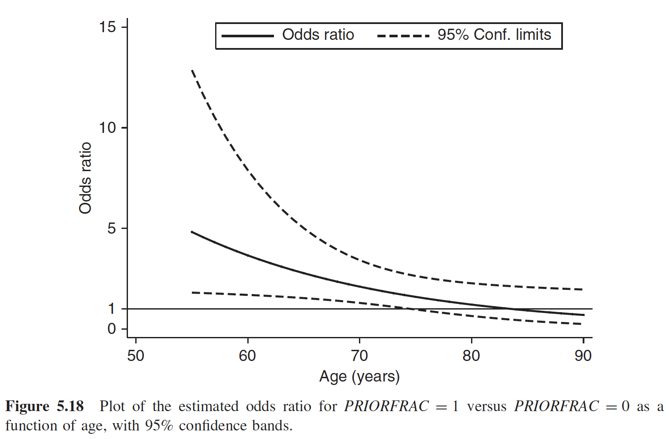
OR for covariates with interaction (VII)
The younger the women is, the story of a prior fracture is more important to the odds of a current fracture
The association of prior fracture becomes not significant after about age 75 (starting where the 95% CI for OR contains 1)

Slide 38
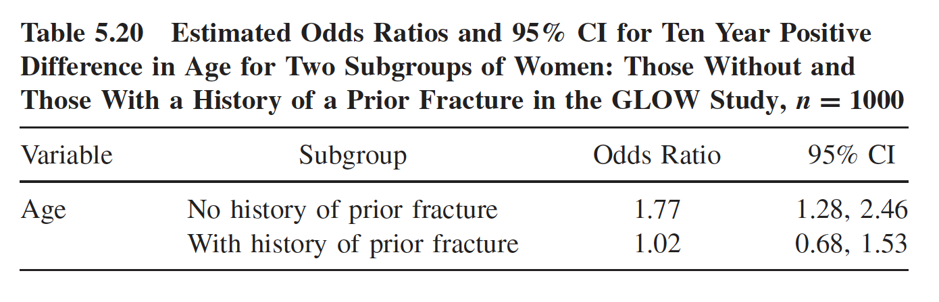
Interpreting ORs for Covariate in Interaction (IV)
Among women without a history of fracture, for every 10 year increase in age odds of fracture increases 1.77 times (95% CI: 1.28, 2.46). Among women with a history of fracture, for every 10 year increase in age odds of fracture increases 1.02 times (95% CI: 0.68, 1.53). Both holding all other covariates constant.

Slide 39
Simple Poisson Regression

Slide 40
Class 16 Learning Objectives
Revisit the logistic regression diagnostic plots
Identify and resolve poorly fit or influential points
Present and interpret odds ratios in the context of our final model
Identify outcomes that can be modelled by Poisson regression

Slide 41
Poisson Distribution
The Poisson distribution is perhaps the second most frequently used discrete distribution after the binomial distribution
Named after the French mathematician Siméon Denis Poisson (1791 – 1840)
This distribution is often used to model count data
Examples:
Distribution of number of death due to lung cancer;
Distribution of number of leukemia;
Distribution of number of ED visits, hospitalizations….

Slide 42
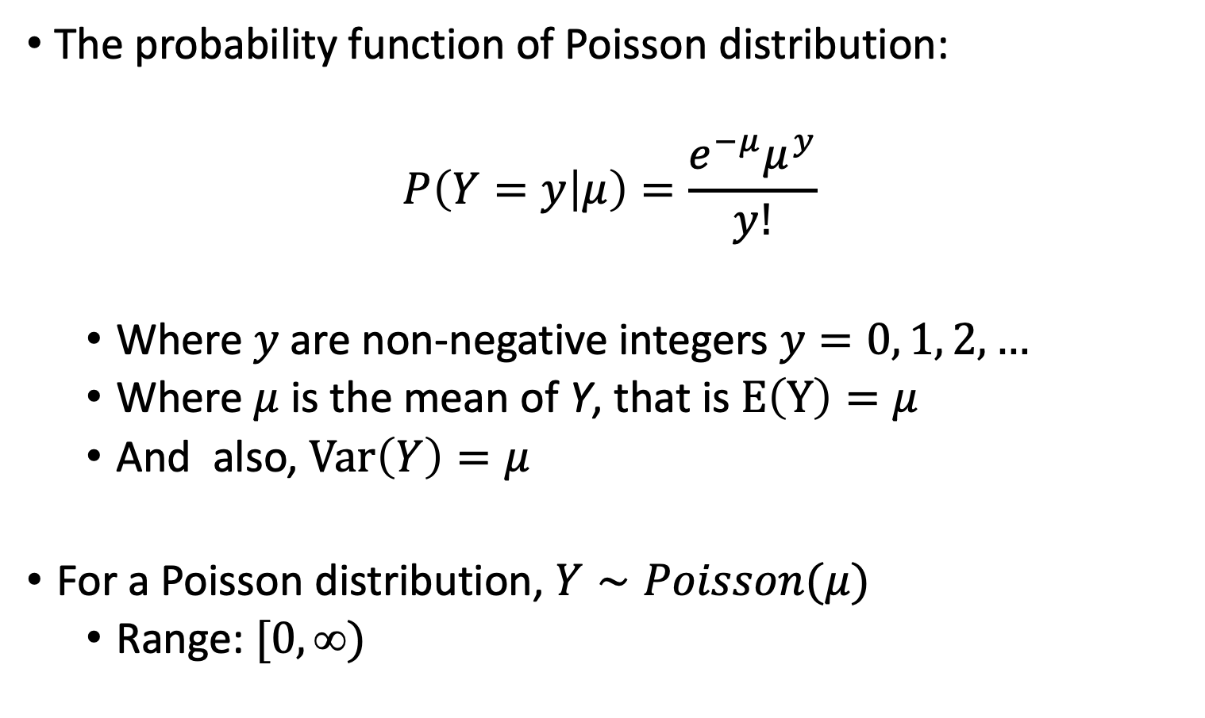
Poisson Distribution (I)
The probability function of Poisson distribution:
$$P\left(Y=y | μ\right)=\frac{e^{−μ}μ^{y}}{y!}$$
Where $y$are non-negative integers $y=0, 1, 2, …$
Where $μ$ is the mean of Y, that is $E\left(Y\right)=μ$
And also, $Var\left(Y\right)=μ$
For a Poisson distribution, $Y∼Poisson(μ)$
Range: $[0, )$

Slide 43
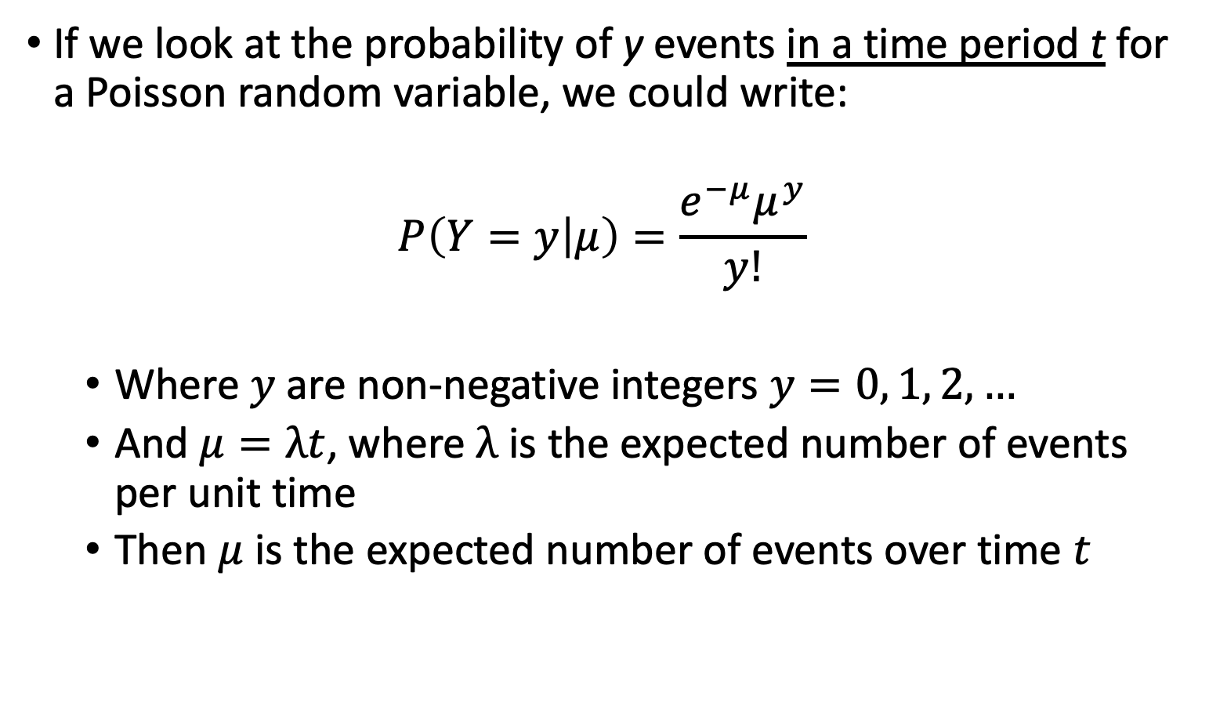
Poisson Distribution (II)
If we look at the probability of y events in a time period t for a Poisson random variable, we could write:
$$P\left(Y=y | μ\right)=\frac{e^{−μ}μ^{y}}{y!}$$
Where $y$are non-negative integers $y=0, 1, 2, …$
And $μ=λt$, where $λ$ is the expected number of events per unit time
Then $μ$ is the expected number of events over time $t$

Slide 44
Poisson Distribution (III)
What does λ represent here?
A rate, the expected number of events in a given population over a given period time.
Often expressed in units such as events per thousand person-years.
The Poisson distribution is the prototype for assigning probabilities of observing any number of events

Slide 45
Person-year and rate (I)
How to calculate Person-years:
One person-year is a unit of time defined as one person being followed for one year
Person-years for a sample of n subjects is calculated as the total years followed for the n subjects, where each subject could have different follow-up time.
A real simple example: suppose we have 5 subjects, two of the subjects were followed for 2 years, and two of them are followed for 3 years and the fifth subject was followed for 3.8 years; then
person-years = 2*2 + 2*3 + 3.8 = 13.8 years.

Slide 46
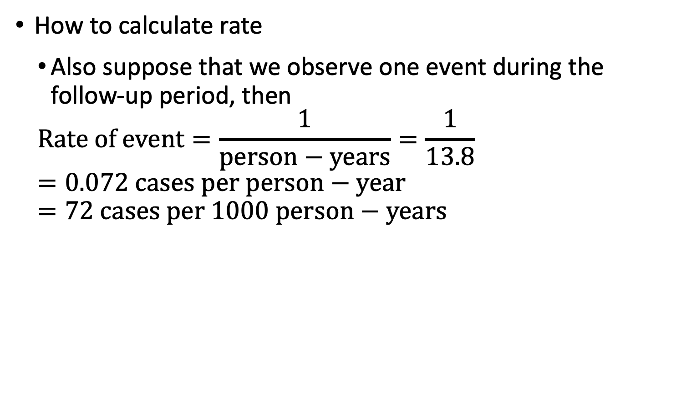
Person-year and rate (II)
How to calculate rate
Also suppose that we observe one event during the follow-up period, then
$$Rate of event=\frac{1}{person−years}=\frac{1}{13.8} =0.072 cases per person−year=72 cases per 1000 person−years$$

Slide 47
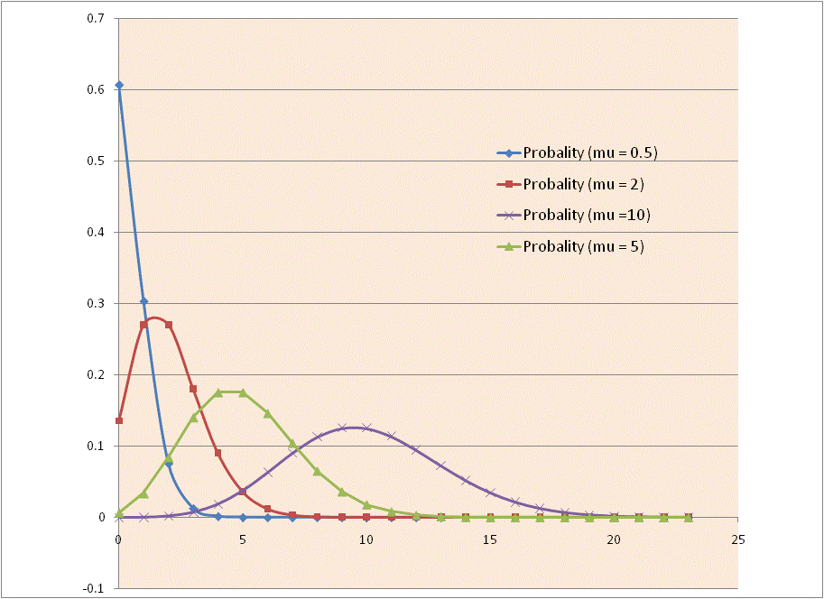
Poisson Distribution
Distribution of Poisson distribution with different mean μ.

Slide 48
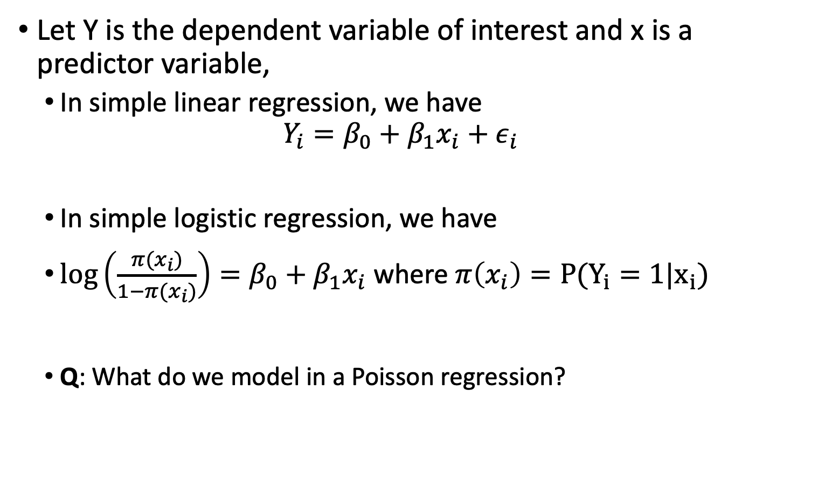
Review: Linear Regression and Logistic Regression
Let Y is the dependent variable of interest and x is a predictor variable,
In simple linear regression, we have
$$Y_{i}=β_{0}+β_{1}x_{i}+ε_{i}$$
In simple logistic regression, we have
$\log\left(\frac{π(x_{i})}{1−π(x_{i})}\right)=β_{0}+β_{1}x_{i}$ where $π\left(x_{i}\right)=P(Y_{i}=1|x_{i})$
Q: What do we model in a Poisson regression?

Slide 49
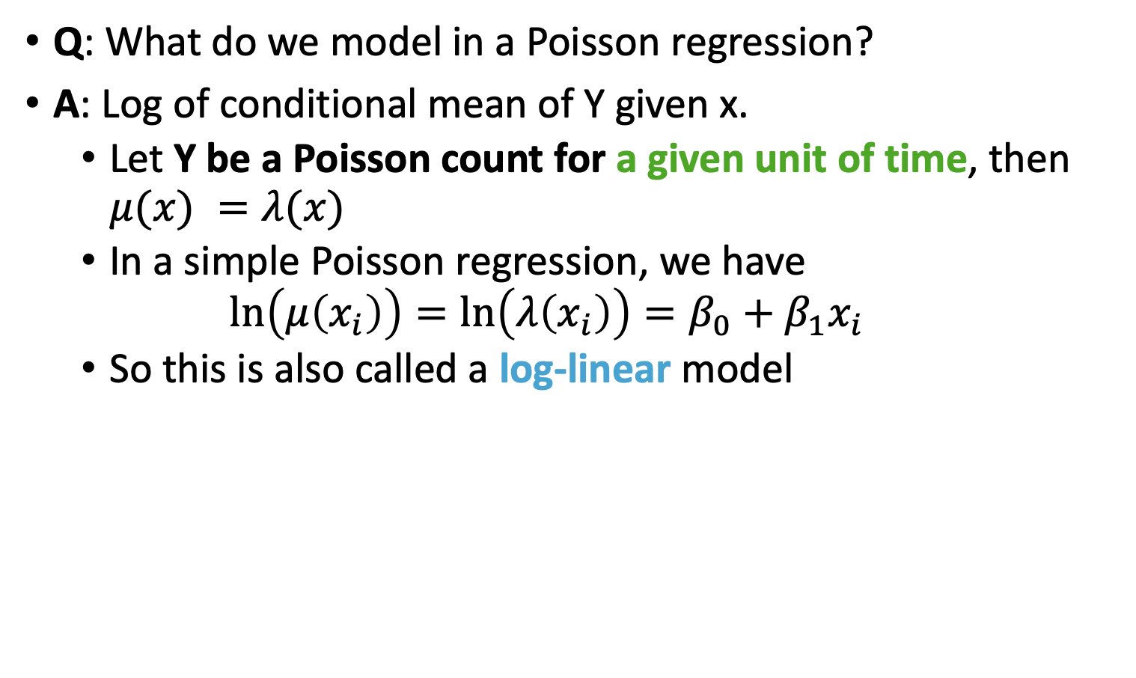
Simple Poisson Regression Model
Q: What do we model in a Poisson regression?
A: Log of conditional mean of Y given x.
Let Y be a Poisson count for a given unit of time, then $μ(x) =λ(x)$
In a simple Poisson regression, we have
$$\ln\left(μ\left(x_{i}\right)\right)=\ln\left(λ\left(x_{i}\right)\right)=β_{0}+β_{1}x_{i}$$
So this is also called a log-linear model

Slide 50
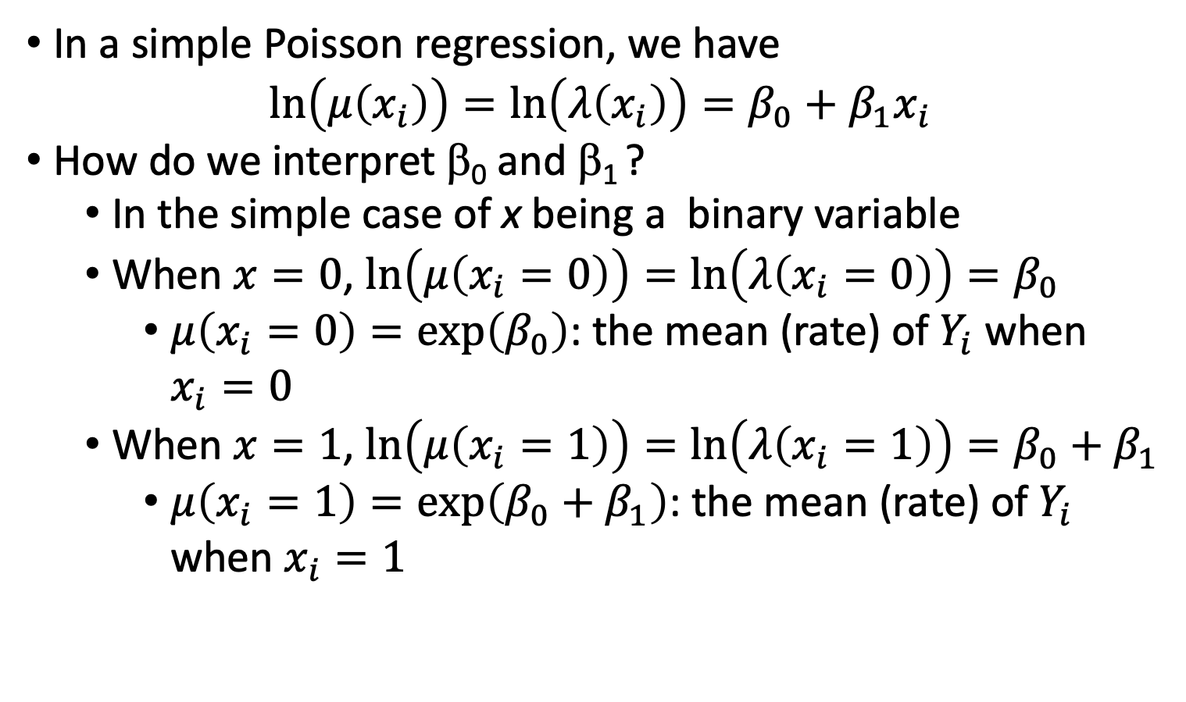
Parameter Interpretation (I)
In a simple Poisson regression, we have
$$\ln\left(μ\left(x_{i}\right)\right)=\ln\left(λ\left(x_{i}\right)\right)=β_{0}+β_{1}x_{i}$$
How do we interpret β₀ and β₁ ?
In the simple case of x being a binary variable
When $x=0$, $\ln\left(μ\left(x_{i}=0\right)\right)=\ln\left(λ\left(x_{i}=0\right)\right)=β_{0}$
$μ\left(x_{i}=0\right)=exp\left(β_{0}\right)$: the mean (rate) of $Y_{i}$ when $x_{i}=0$
When $x=1$, $\ln\left(μ\left(x_{i}=1\right)\right)=\ln\left(λ\left(x_{i}=1\right)\right)=β_{0}+β_{1}$
$μ\left(x_{i}=1\right)=exp\left(β_{0}+β_{1}\right)$: the mean (rate) of $Y_{i}$ when $x_{i}=1$

Slide 51
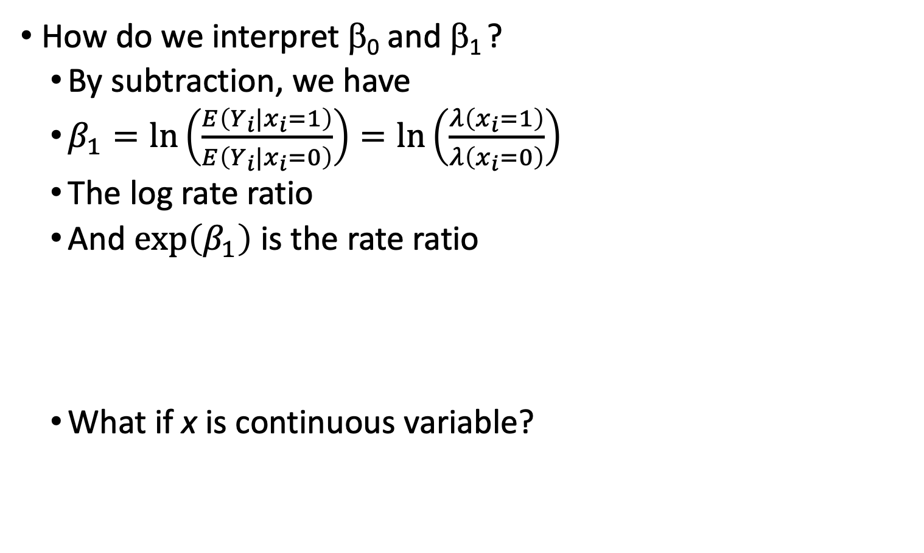
Parameter Interpretation (II)
How do we interpret β₀ and β₁ ?
By subtraction, we have
$β_{1}=\ln\left(\frac{E\left(Y_{i}|x_{i}=1\right)}{E\left(Y_{i}|x_{i}=0\right)}\right)=\ln\left(\frac{λ\left(x_{i}=1\right)}{λ\left(x_{i}=0\right)}\right)$
The log rate ratio
And $\exp\left(β_{1}\right)$ is the rate ratio
What if x is continuous variable?

Slide 52
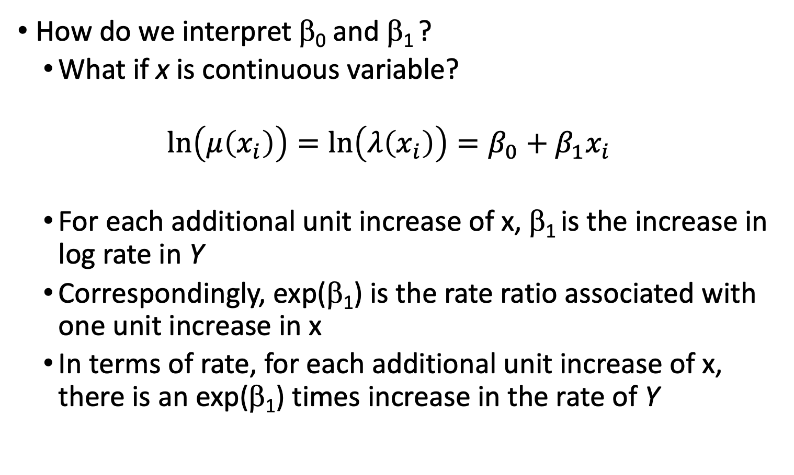
Parameter Interpretation (III)
How do we interpret β₀ and β₁ ?
What if x is continuous variable?
$$\ln\left(μ\left(x_{i}\right)\right)=\ln\left(λ\left(x_{i}\right)\right)=β_{0}+β_{1}x_{i}$$
For each additional unit increase of x, β₁ is the increase in log rate in Y
Correspondingly, exp(β₁) is the rate ratio associated with one unit increase in x
In terms of rate, for each additional unit increase of x, there is an exp(β₁) times increase in the rate of Y

Slide 53
Model Construction – Include Offset (I)
What if we have data that each observation has different period of time?
For example, we look at number of ED visits when subjects are enrolled in Oregon Health Plan, however, each subjects are enrolled in the plan for different length of time…
How do we incorporate this different length of time?

Slide 54
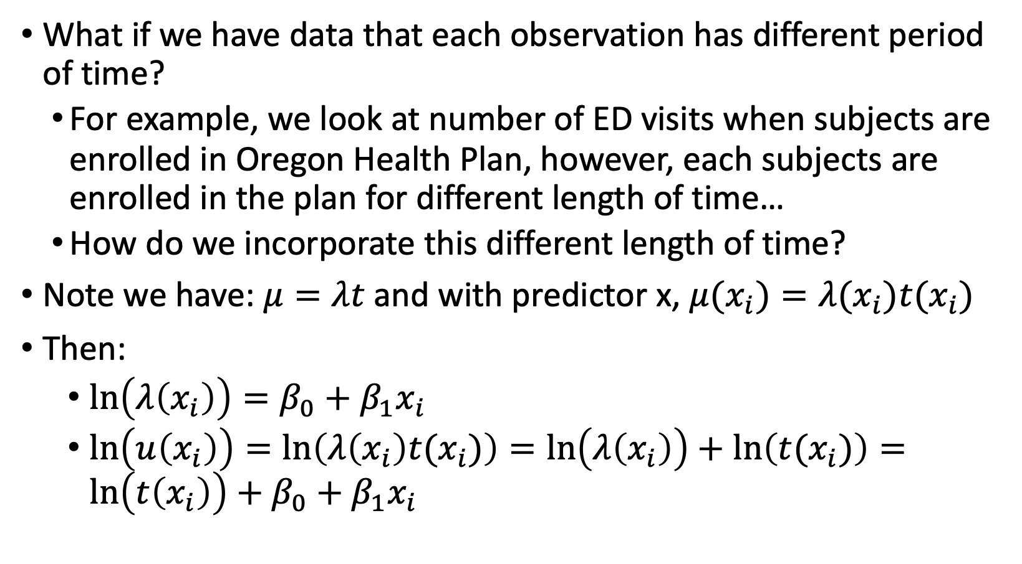
Model Construction – Include Offset (I)
What if we have data that each observation has different period of time?
For example, we look at number of ED visits when subjects are enrolled in Oregon Health Plan, however, each subjects are enrolled in the plan for different length of time…
How do we incorporate this different length of time?
Note we have: $μ=λt$ and with predictor x, $μ(x_{i})=λ(x_{i})t(x_{i})$
Then:
$\ln\left(λ\left(x_{i}\right)\right)=β_{0}+β_{1}x_{i}$
$\ln\left(u\left(x_{i}\right)\right)=\ln\left(λ\left(x_{i}\right)t(x_{i})\right)=\ln\left(λ\left(x_{i}\right)\right)+\ln\left(t(x_{i})\right)=\ln\left(t\left(x_{i}\right)\right)+β_{0}+β_{1}x_{i}$

Slide 55
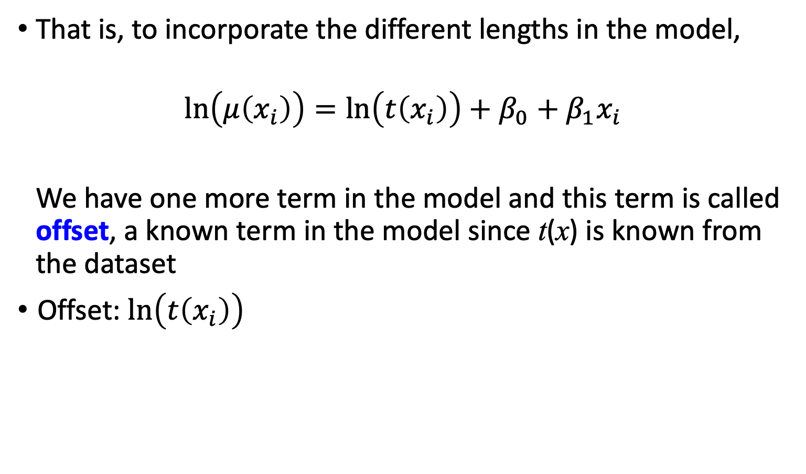
Model Construction – Include Offset (II)
That is, to incorporate the different lengths in the model,
$$\ln\left(μ\left(x_{i}\right)\right)=\ln\left(t\left(x_{i}\right)\right)+β_{0}+β_{1}x_{i}$$
We have one more term in the model and this term is called offset, a known term in the model since t(x) is known from the dataset
Offset: $\ln\left(t\left(x_{i}\right)\right)$

Slide 56
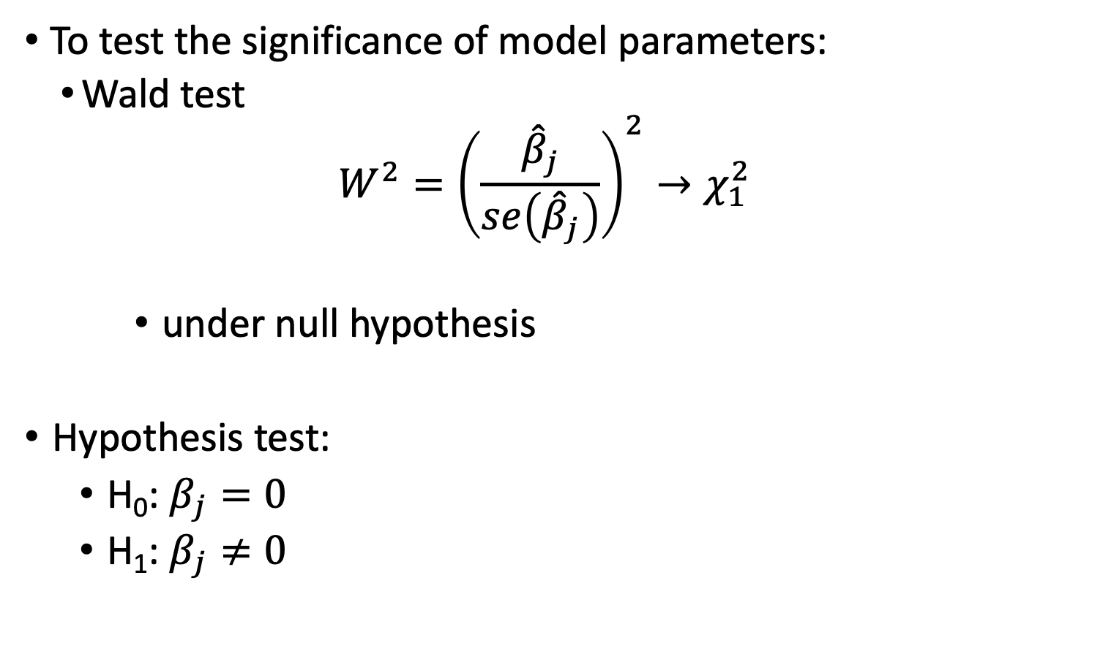
Test for Significance in Parameter (I)
To test the significance of model parameters:
Wald test
$$W^{2}={\left(\frac{{\hat{β}}_{j}}{se\left({\hat{β}}_{j}\right)}\right)}^{2}→χ_{1}^{2}$$
under null hypothesis
Hypothesis test:
H₀: $β_{j}=0$
H₁: $β_{j}≠0$

Slide 57
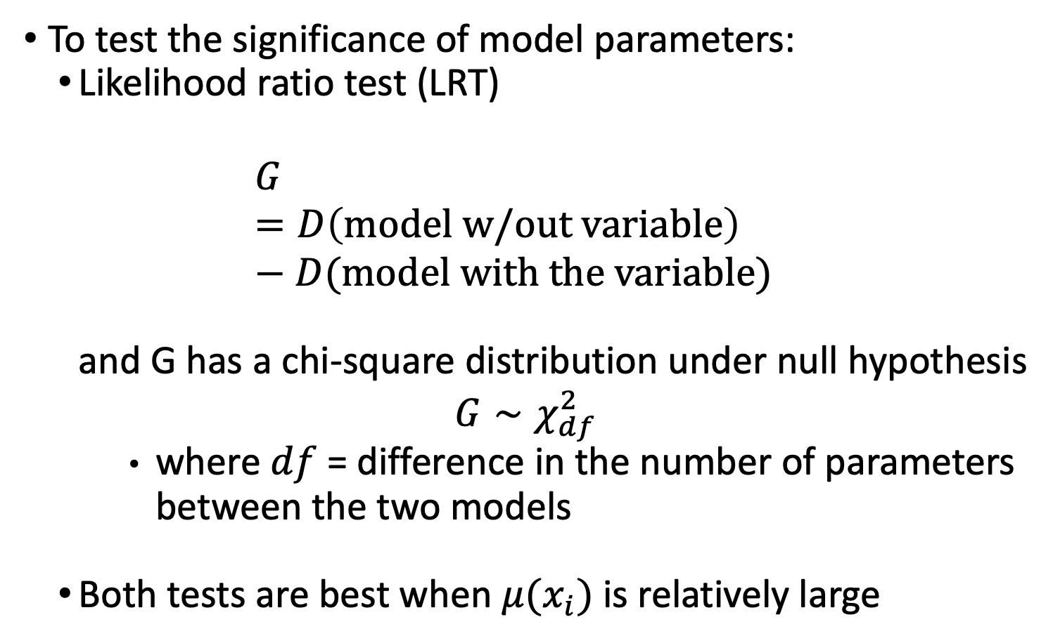
Test for Significance in Parameter (II)
To test the significance of model parameters:
Likelihood ratio test (LRT)
$$G=D\left(model w/out variable\right)−D(model with the variable)$$
and G has a chi-square distribution under null hypothesis
$$G∼χ_{df}^{2}$$
where $df$ = difference in the number of parameters between the two models
Both tests are best when $μ(x_{i})$is relatively large

Slide 58

Wrap-up
4-minute exit ticket
Question about “on call” times
Next class
Continue Poisson Regression
https://forms.office.com/r/1upgU9mfxU

